Slide 1
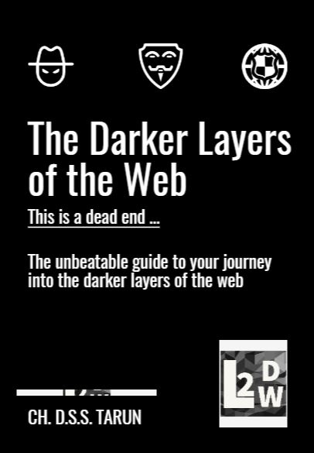

Slide 2
Acknowledgements
I would firstly like to thank my family that supported and encouraged me while I was writing the book. Then I would like to thank my teammates, classmates and my teachers who helped me in gaining knowledge on this subject that helped me in writing a book which inspired me a lot while doing this project. I hereby transfer my entire knowledge to the ones who are reading my book. I hope you gain the knowledge and information on the subject/topic just like I did. Enjoy reading the book. Thank you.

Slide 3
ABOUT US
The inspiration for me to write this book are the people that surrounded me. Everyone is familiar with the upper layer of the web that is the surface web, but when it comes to the deeper and the darker layers, the knowledge is almost zero. That's the reason I strived to write this book so that even the ones with very little and basic knowledge can learn, implement and enhance their capabilities and surpass their limitations so that they will know the whole web. This book helps people understand the layers of the web in a very informative way because the book itself was written so that it was minimalistic and simplistic.

Slide 4
Table of Contents
Glacier of Web
Surface Web
Deep Web
Dark Web

Slide 5

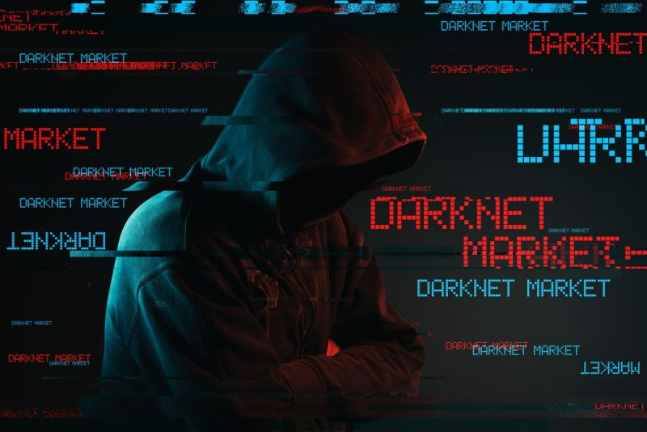

Slide 6
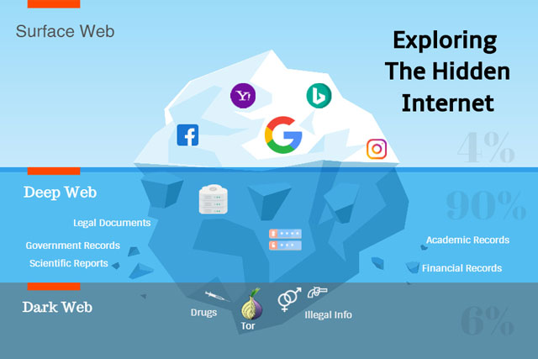
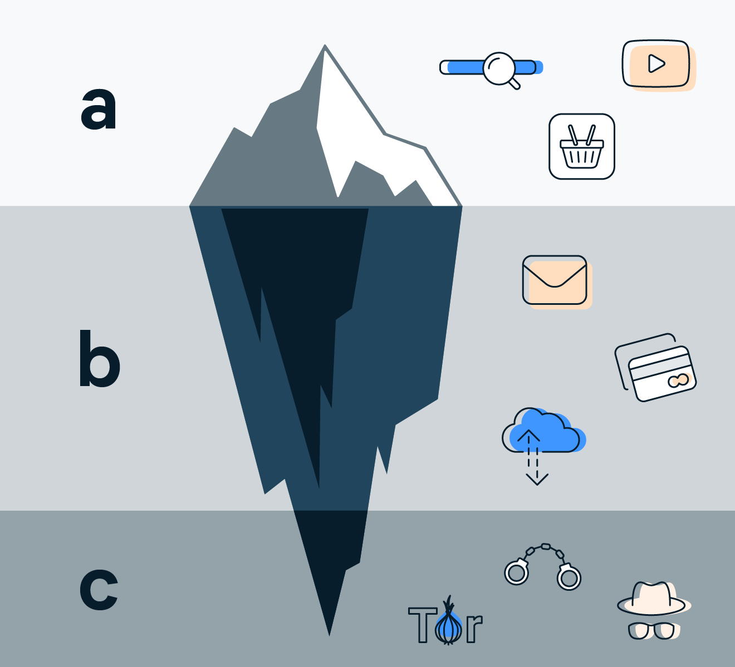
1st PART : Glacier of Web

Slide 7
Glacier of web
This is the GLACIER of Web. It shows the various things that can be found at every level of the web.
a)The Surface Web - The First Layer of the Web. b)The Dark Web - The Second Layer of the Web. c)The Deep Web - The Third Layer of the Web.
The detailed explanation to each of these will be given in the lower sections of the book. The Glacier/ Iceberg is divided into various sections which can display the various things that we can access in each respective section.

Slide 8
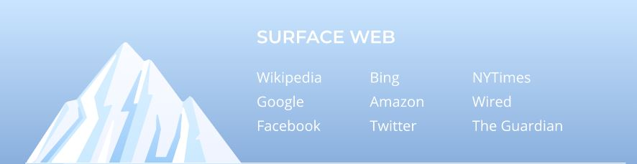
2ND PART : SURFACE WEB
Surface Web is the first layer on the internet. Is it very small in comparison to the bottom layers. Hence, it is compared to the top the glacier diagram. It can be directly accessed thru the normal browsers such as Google Chrome, Mozilla Firefox, Opera, etc. It is also known as the "TIP OF THE ICEBERG". The common things such as E-Commerce Websites, WIKIPEDIA, YouTube, Gmail, Yahoo, etc. can be accessed without any issues. The Surface Web constitutes the 4% to 5% of the whole web. The web we use in our day-to-day lives is the surface web. The Surface Web is the portion of the World Wide Web that is readily available to the general public and searchable with standard web search engines.

Slide 9
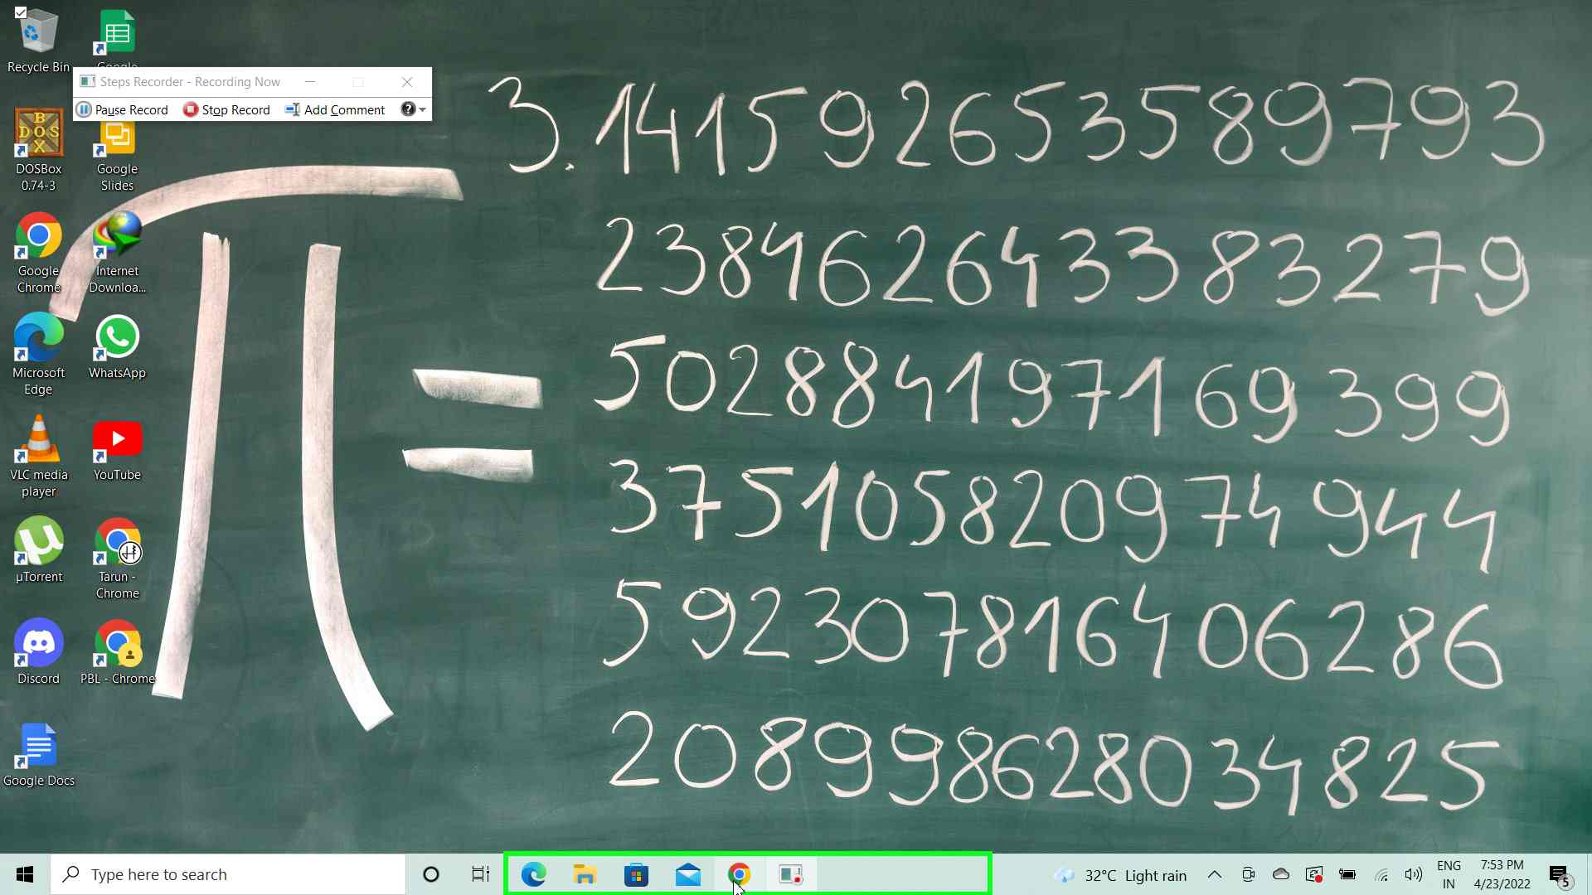
Things that we need to access the surface web are:
Computer/Mobile
A Router
Internet Connection
Browser
Basic Computer Knowledge
Steps to access the surface web :-

Slide 10
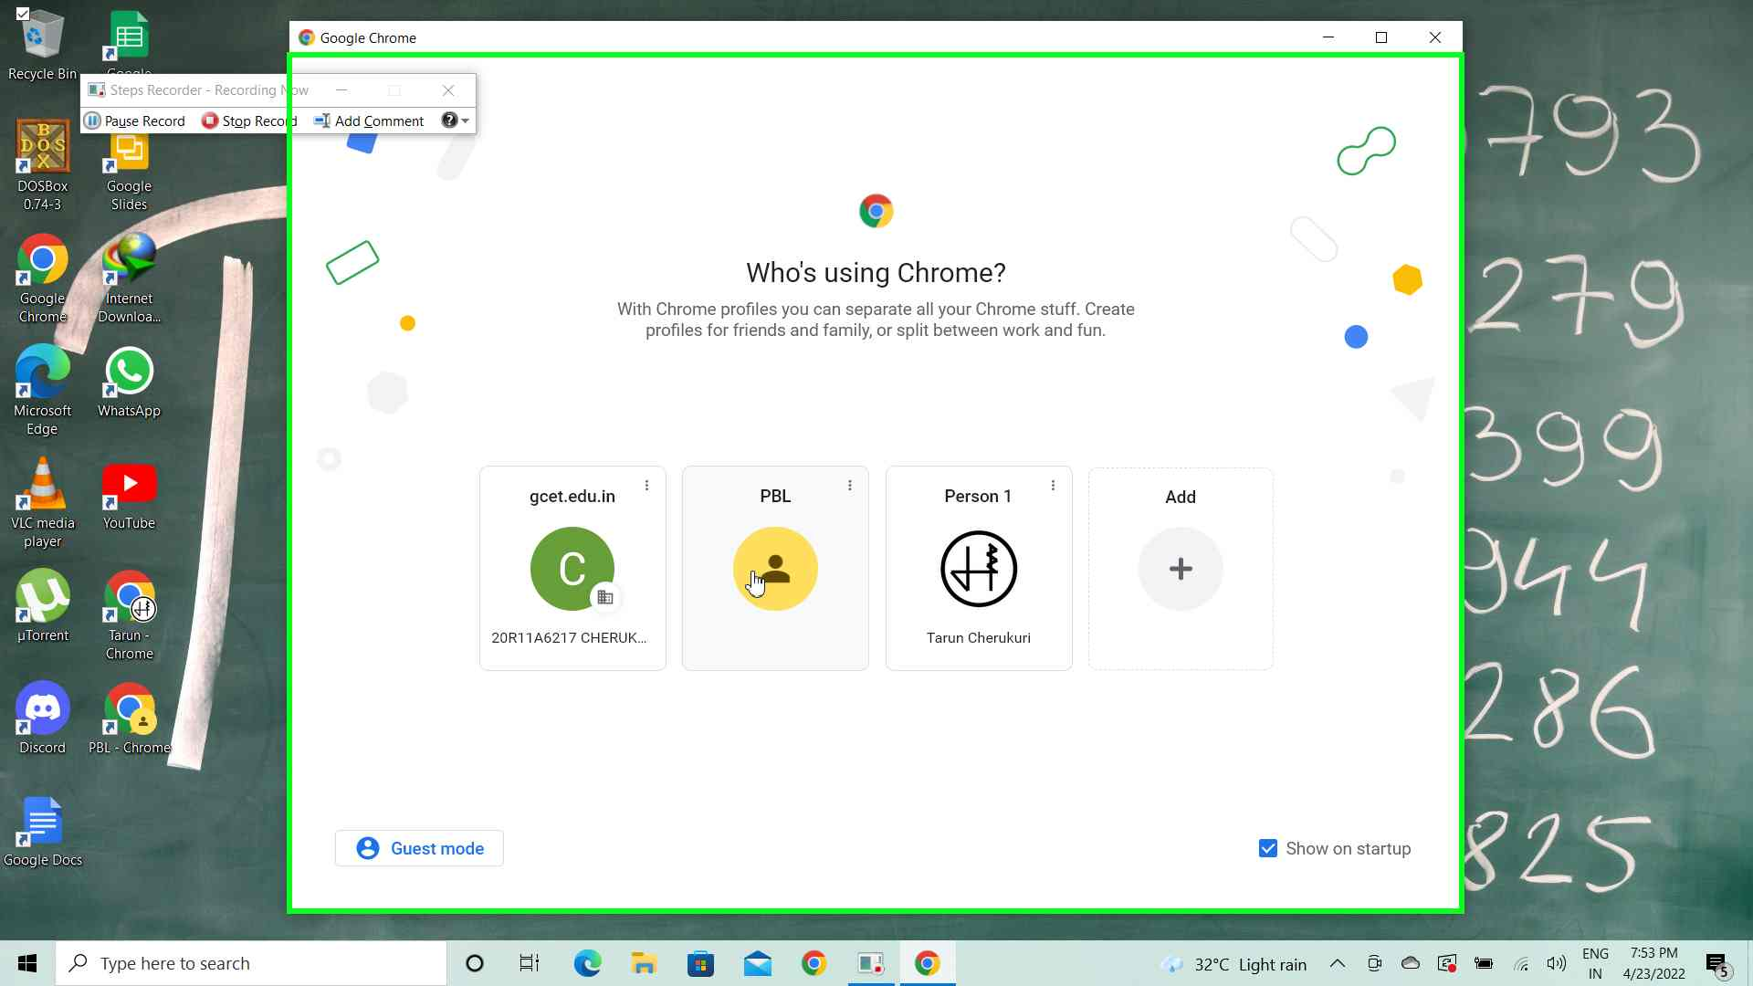
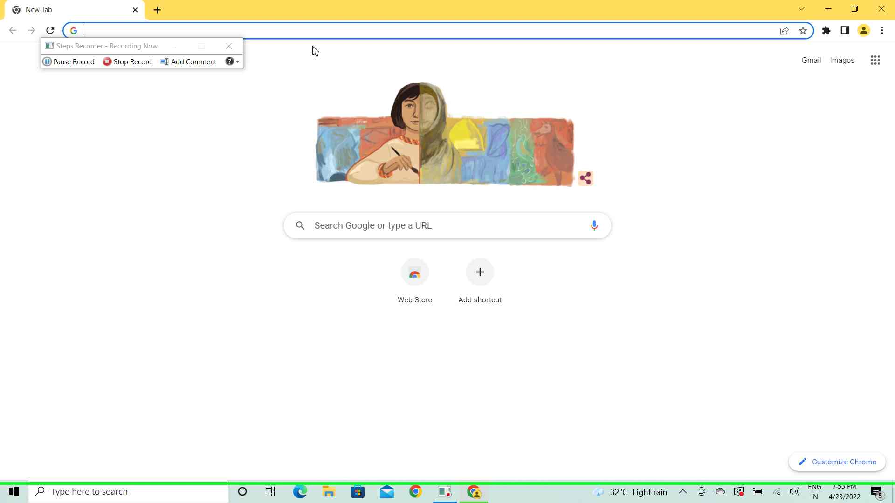

Slide 11
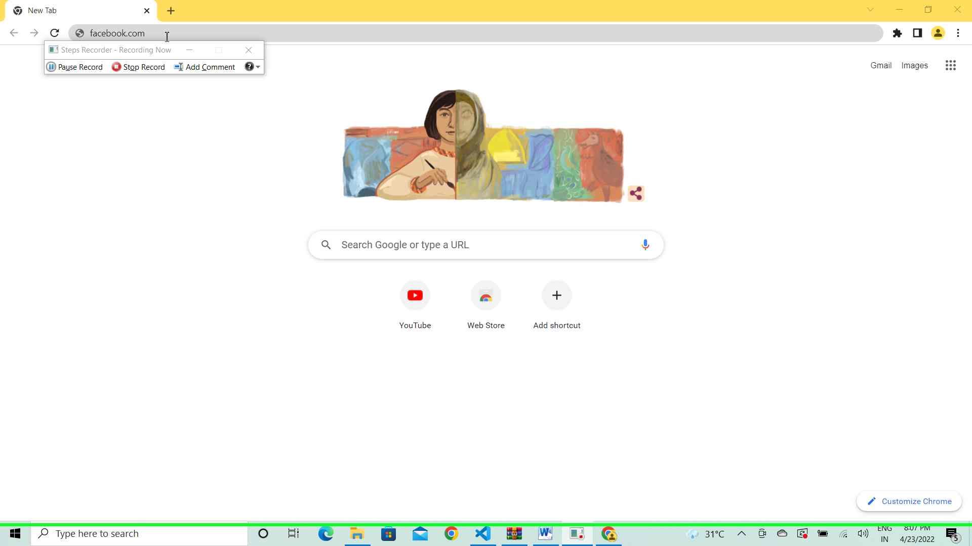
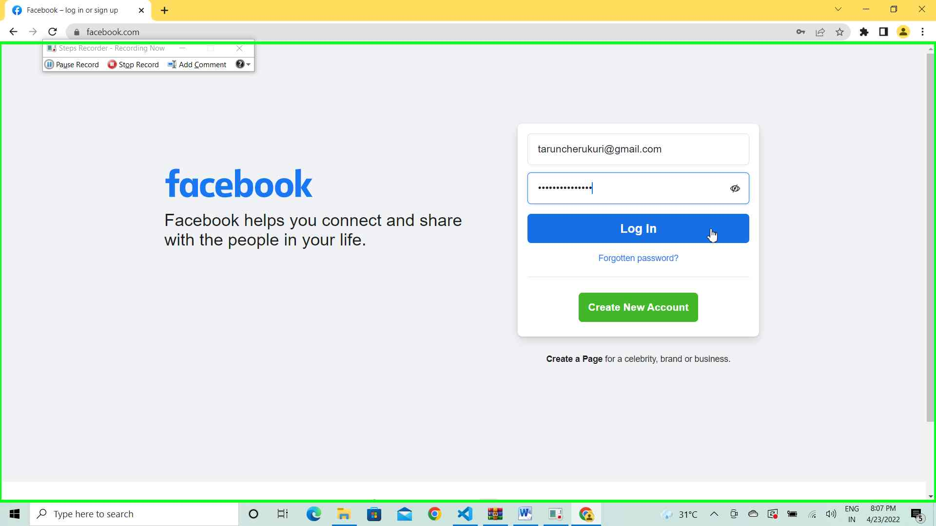

Slide 12
3RD PART : DEEP WEB
What is Deep Web? Deep Web is the second layer on the internet. Is it very huge when compared to the other two layers. That's the reason it is compared to the middle part of the glacier diagram. The Deep Web Information can't be directly accessed but it can be accessed once the IP Address(Internet Protocol Address) & the password is known. In comparison to the dark web, the deep web can be accessed easily as it is not as complicated as Dark Web access. The Dark Web primarily consists of Secret Military Information, Bank Information and also National Public Records such as Aadhar Data, Bank Account Numbers. The main thing that differentiates Deep Web from Surface Web is Authority. The once who have authority can access and the ones who don't have authority can't access it. The Deep Web constitutes the 90% of the whole web. The web we use in our day-to-day lives is the surface web. Things that we need to access the surface web are: Other names for Deep Web is Invisible web/ Hidden Web. These are not indexed like the standard web search-engines. The content of the deep web can be located and accessed by a direct URL or IP address, but may require a password or other security access to get past public pages.

Slide 13
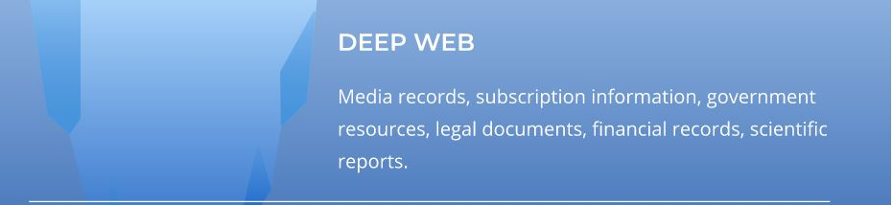
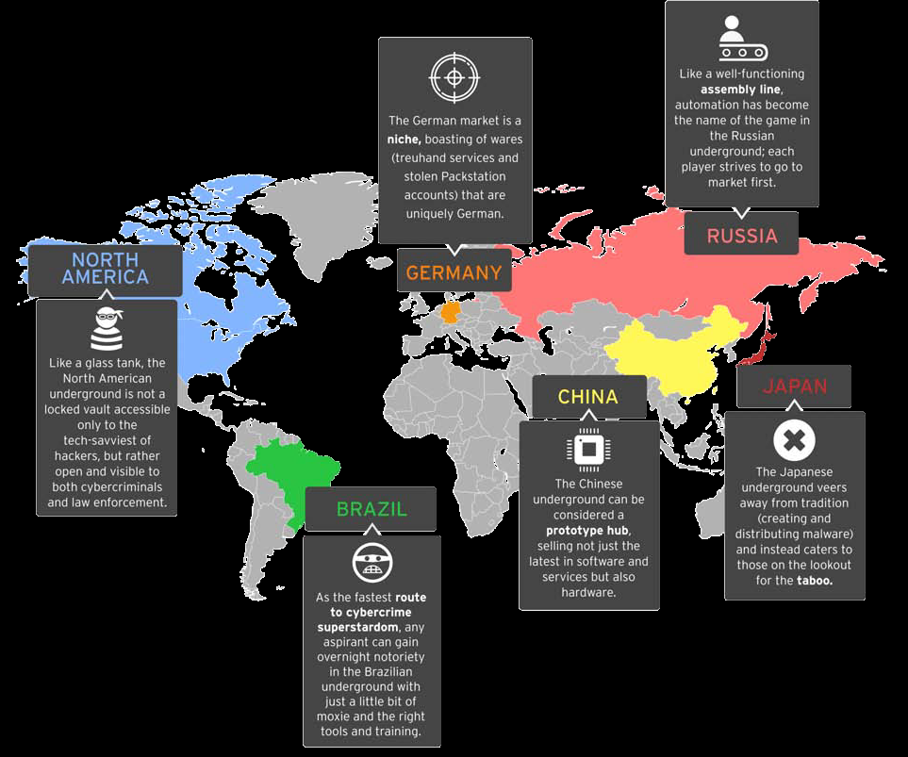
Why did they make Deep Web? The need for anonymized and encrypted network that could protect sensitive communications and information by the two research organizations in the US Department of Defense laid the foundation to the deep web. They drove efforts to develop this and the result was Deep and Dark Web which were secret network that would not be known or accessible to ordinary internet surfers.

Slide 14
What do we need to access this? DeepPeep, Intute, Deep Web Technologies, Scirus, and Ahmia.fi are a few search engines that have accessed the deep web. Only the Advanced Internet Users can access the Deep Web. Do not access the deep web with no prior knowledge about it because it contains medical records, subscription information, government resources, legal documents, financial records, scientific reports and mishandling them is considered as cyber crime which is a threat to the country.
Researchers have been exploring how the deep web can be crawled in an automatic fashion, including content that can be accessed only by special software such as Tor(will be discussed in Dark Web Section) Commercial search engines have begun exploring alternative methods to crawl the deep web. The Sitemap Protocol (first developed, and introduced by Google in 2005) and OAI-PMH are mechanisms that allow search engines and other interested parties to discover deep web resources on particular web servers. Both mechanisms allow web servers to advertise the URLs that are accessible on them, thereby allowing automatic discovery of resources that are not directly linked to the surface web. Google's deep web surfacing system computes submissions for each HTML form and adds the resulting HTML pages into the Google search engine index.

Slide 15
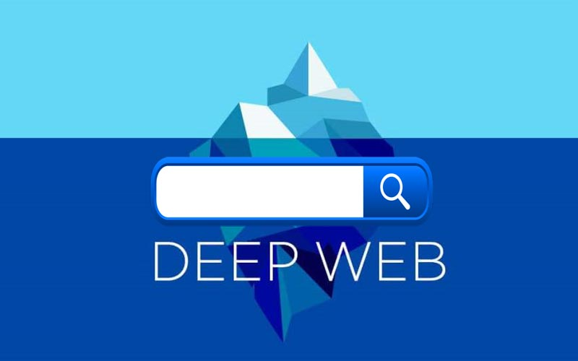
The surfaced results account for a thousand queries per second to deep web content. In this system, the pre-computation of submissions is done using three algorithms:
1)Selecting input values for text search inputs that accept keywords.
2)Identifying inputs that accept only values of a specific type (e.g., date).
3)Selecting a small number of input combinations that generate URLs suitable for inclusion into the Web search index.

Slide 16
Operating Systems used to access The Deep Web : 1) TAILS OS THE GOAL OF TAILS OS IS TO NOT LEAVE ANY TRACES. Tails OS (Debian based) is designed to provide privacy and anonymity; it is the tried and true method of using Live OS on a USB flash drive, which means the OS is installed on separate hardware than the host (your computer), and that all documents and activity live in RAM (volatile memory) which essentially gets deleted once the OS is shutdown or the USB drive is removed, aka amnesiac: forgets about everything that happened. 2) QUBES OS THE GOAL OF QUBES OS IS : VIRTUALIZATION TO CREATE ISOLATION. Tails OS (Debian based) is designed to provide privacy and anonymity; it is the tried and true method of using Live OS on a USB flash drive, which means the OS is installed on separate hardware than the host (your computer), and that all documents and activity live in RAM (volatile memory) which essentially gets deleted once the OS is shutdown or the USB drive is removed, aka amnesiac: forgets about everything that happened.

Slide 17
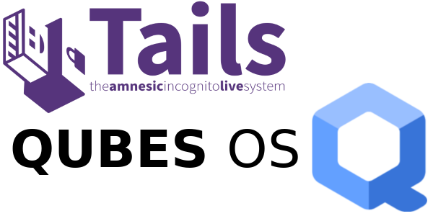
THE LOGOS FOR TAILS AND QUBES OPERATING SYSTEMS :

Slide 18
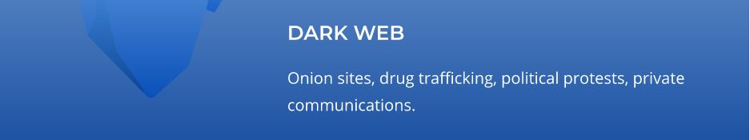
4TH PART : DARK WEB
What is Dark Web? The dark web first officially appeared in the early 2000s along with the creation of Freenet, which was developed by Ian Clarke to secure users against government intervention and cyber attacks. The system, which is still available today, allows users to express themselves freely without being tracked online. The U.S. Naval Research Laboratory funded a project called The Onion Router (TOR). TOR offered intelligence sources a way to communicate easily and safely, especially in hostile areas where personal safety is key. It is now one of the most common browsers used to access the dark web, using databases to help people make their way around and find the information they need. Ross Ulbricht was invested and arrested in 2013 for creating and running the dark web site The Silk Road, a darknet website authorities said was used to buy and sell narcotics. This constitutes approximately 5-6% of the web.

Slide 19
Why did they make Deep Web? The rise of cryptocurrencies increased the popularity of the dark web, especially for cybercriminals. That's because digital currencies often provide a great deal of anonymity for people who buy and sell on the dark web. Because of its association with certain illicit activities, there have been calls for regulation of the dark web. For instance, the G20 and the Financial Action Task Force (FATF) have both called for cryptocurrency companies to provide information on buyers and sellers in transactions conducted online. This is especially true, they say, to help law enforcement track criminal organizations and illicit activities.
What makes this different? As you surf, you'll probably notice that dark website addresses end with the .onion extension rather than the traditional .com, .org, .edu, etc. One word of warning, though. Make sure you have some security software installed because there's a good chance that you may come in contact with malware and phishing scams.

Slide 20
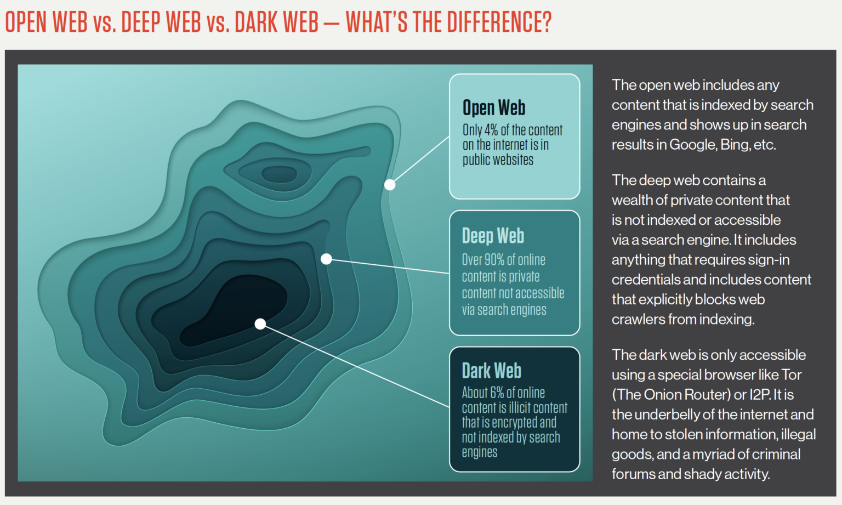

Slide 21

How do we get access ? You can access the dark web by installing specific, anonymous browsers, such as TOR. Once installed, the browser works the same way traditional ones do. But it can be a little difficult to access information because it doesn't use an index to locate the desired information. Make sure that you install security software to make sure your computer and personal information are kept safe.
What are the things we need to know & What are the prerequisites ? TOR BROWSER :

Slide 22
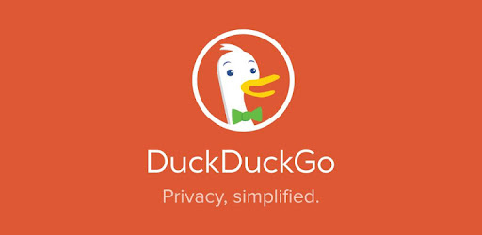
Despite its current usage as a browser that is often used to access parts of the Dark Web, TOR (aka. the Dark Web browser) was originally developed to help safeguard US Intelligence online communications. Today, it is one of the few ways to access .onion websites, which are located on the Dark Web. TOR is a variant of the popular Firefox web browser, modified to allow users to browse the web anonymously. The browser is designed to block or advise against user attempts to do things that might reveal their identity, such as resizing the dimensions of the browser window, for example. Make sure the tor browser is up to date before accessing the dark web because if it is not updated, some of the additional/normal security features may be compromised. This is one of the key things to keep in mind while accessing the dark web.
DUCKDUCKGO :

Slide 23
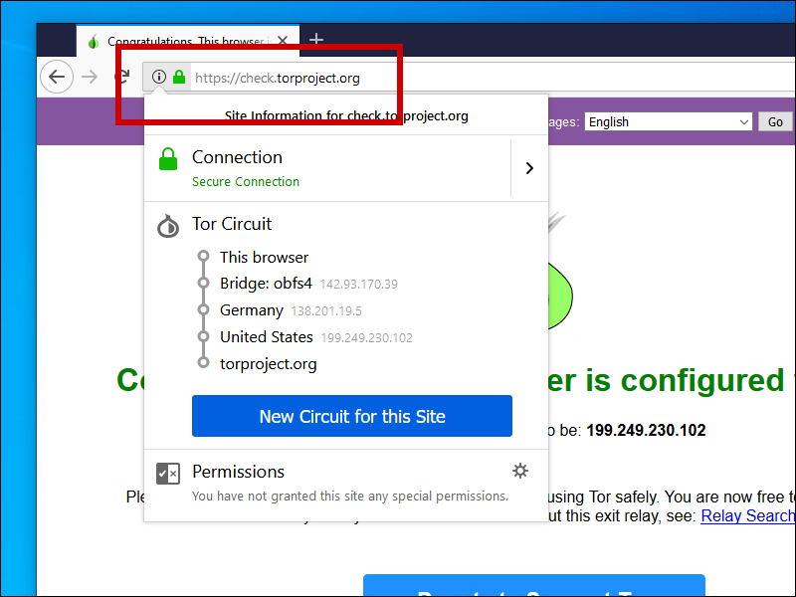
DuckDuckGo (DDG) is an internet search engine that emphasizes protecting searchers' privacy and avoiding the filter bubble of personalized search results. DuckDuckGo does not show search results from content farms. It uses various APIs of other websites to show quick results to queries and for traditional links it uses the help of its partners (mainly Bing) and its own crawler.(A web crawler, or spider, is a type of bot that is typically operated by search engines. Their purpose is to index the content of websites all across the Internet so that those websites can appear in search engine results.)
BRIDGES :

Slide 24
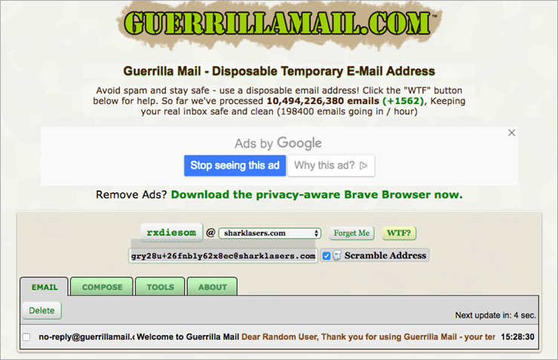
Tor bridges are secret Tor relays that keep your connection to the Tor network hidden. Use a bridge as your first Tor relay if connecting to Tor is blocked or if using Tor could look suspicious to someone who monitors your Internet connection. The Obfs4 Bridge client takes the Tor-encrypted payload and seals it up with the Obfs4 function. The sealed packets are then sent to the Obfs4 Bridge relay. Unsealing them, the Bridge relay gets the Tor encrypted packets and forwards them to the next Tor relay of the Tor circuit.
TEMPORARY EMAILS :

Slide 25
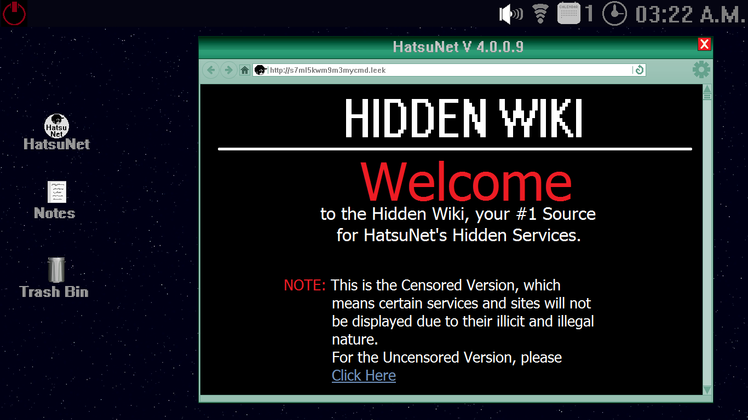
If your personal information such as your email address is spotted on the dark web, it likely means that you have been affected by a data breach. Finding yourself in such a situation is not normal. Hence, usage of temporary email-ids on the dark web is very much preferred as we can generate them with no personal information and we can later dispose them after usage. This is a very basic thing that we follow while using the dark web.
HIDDEN WIKI :

Slide 26

The Hidden Wiki is the name of several censorship-resistant wikis operating as Tor hidden services that anyone can anonymously edit after registering on the site. The main page serves as a directory of links to other onion sites. Its main page provided a community-maintained link directory to other hidden services, including links claiming to offer money laundering, contract killing, cyber-attacks for hire, contraband chemicals, and bomb making. It is illegal to access the dark web and the hidden wiki in many countries.
CURRENCY ON THE DARK WEB - BITCOIN $$$

Slide 27
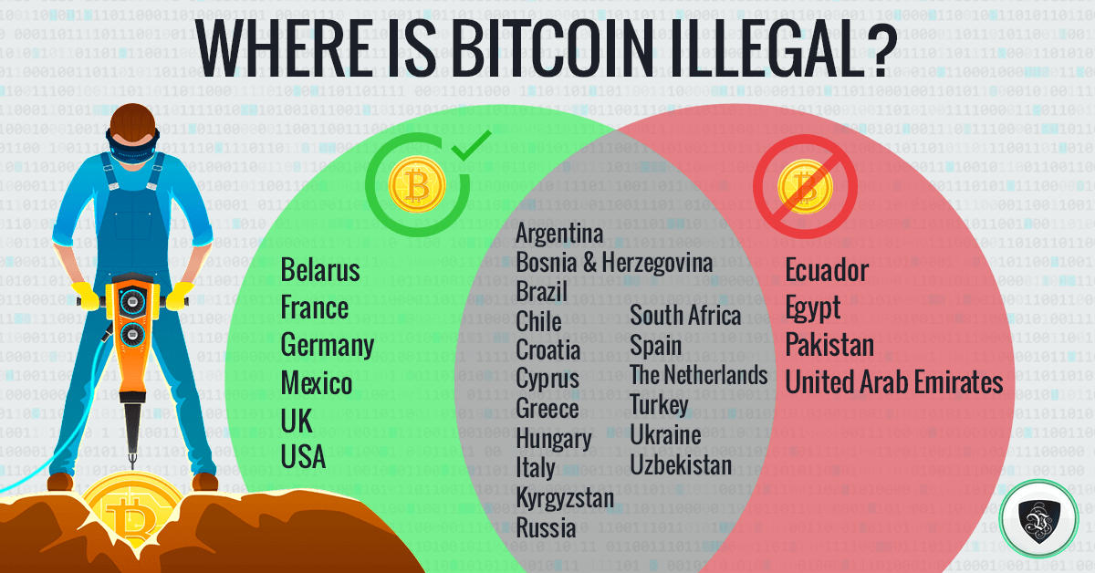
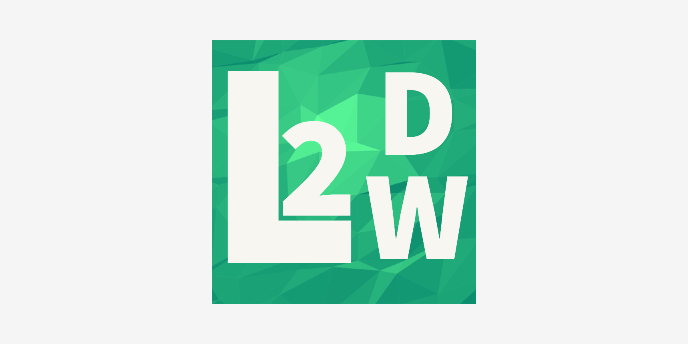
Bitcoin is accepted at all e-commerce storefronts on the dark web. However, a number of studies confirm that cryptocurrencies are used minimally on the Dark Web. According to the latest analysis by Chainalysis, only 0.08% of overall incoming cryptocurrency transactions were used for purchases on dark markets. Bitcoin (BTCUSD) is often referred to as digital currency and as an alternative to central bank-controlled fiat money. However, the latter is valuable because it is issued by a monetary authority and is widely used in an economy.

Slide 28
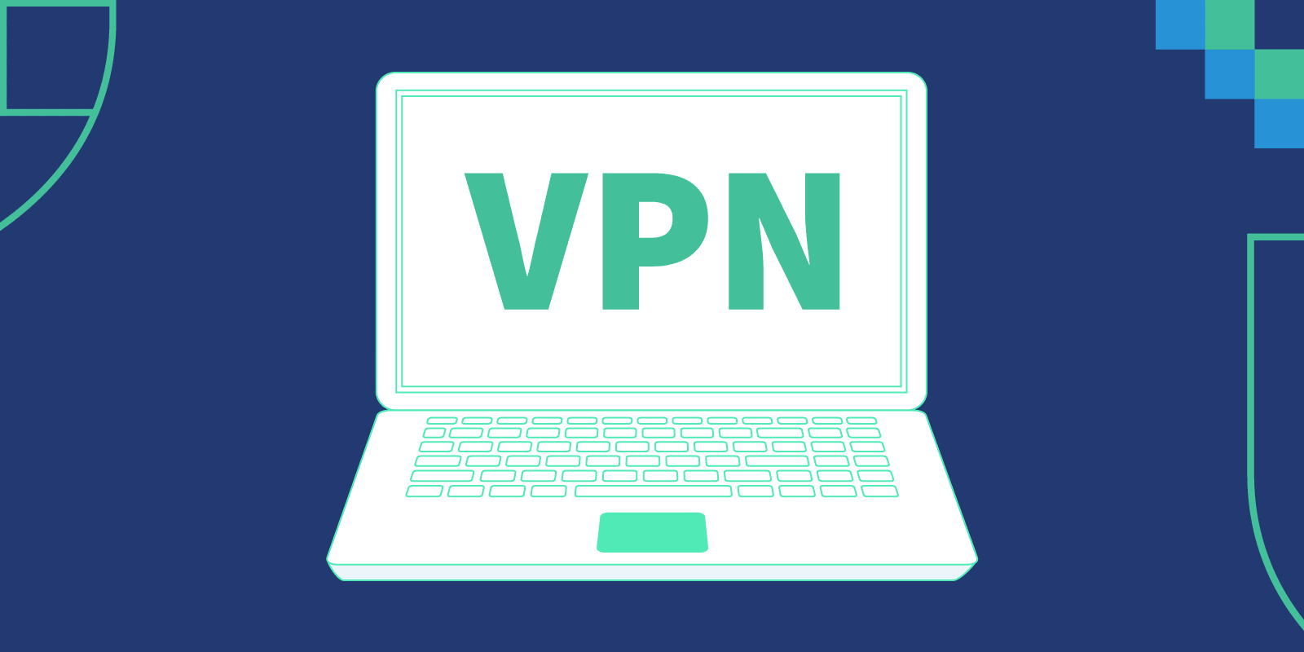
VPN (VIRTUAL PRIVATE NETWORK)
The use of a Virtual Private Network (VPN) is highly
recommended – they help to protect your online privacy,
keep your identity safe and protect all data that’s being
sent to and from your device. But make sure the VPN
you’re using meets a few basic criteria. You will want to
choose one which is based out of a country without strict
data retention laws, like NordVPN which is based in the
Panama. Top quality service providers like this help
assure your privacy and security well. Best VPN for the
Dark Web When looking for a VPN for Dark Web surfing,
there are certain criteria you need to be aware of:
1)No logging policy
2)Company based outside 5/9/14-Eyes Alliance Country
3)Robust encryption
4)Payment in crypto currency
5)Order directly from the Dark Web
6)Compatible with major devices and platforms

Slide 29
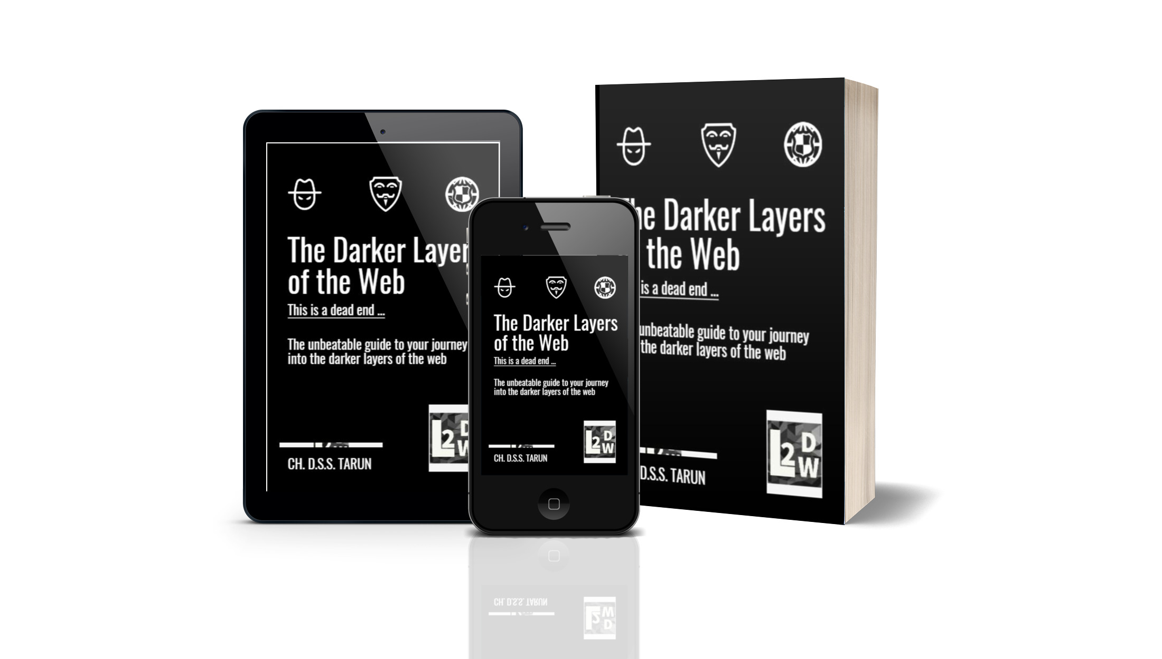
THIS BOOK IS EVEN AVAILABLE IN AUDIOBOOK FORMAT AND HARDCOPY.

